Slide 1
Level 1 Data Science | Data Importing, Transforming & Plotting
05.22.2019
John Solis
Manager
TECH | TELeMetrics Productivity Solutions

Slide 2
Overview
Data science has become an essential skill needed to support customers who are using data to drive equipment performance.
Fault Detection Classification (FDC)
Statistical Process Control (SPC)
First Time Right (FTR)
This course will provide necessary skills to generate insight from most data files.

Slide 3

Platform Introduction
This class will be utilizing R.
R is a language and environment for statistical computing and graphics. It includes
an effective data handling and storage facility,
a suite of operators for calculations on arrays, in particular matrices,
a large, coherent, integrated collection of intermediate tools for data analysis,
graphical facilities for data analysis and display either on-screen or on hardcopy, and
a well-developed, simple and effective programming language which includes conditionals, loops, user-defined recursive functions and input and output facilities.

Slide 4
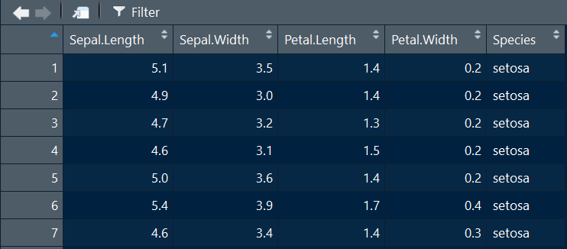
Data Frame
A data frame is a table or a two-dimensional array-like structure in which each column contains values of one variable and each row contains one set of values from each column.
Following are the characteristics of a data frame.
The column names should be non-empty.
The row names should be unique.
The data stored in a data frame can be of numeric, factor or character type.
Each column should contain same number of data items.
Column Names
Row Names
Data

Slide 5
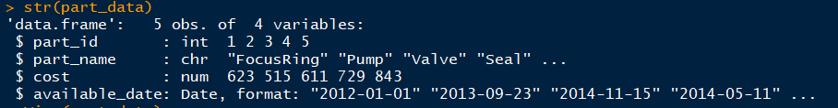
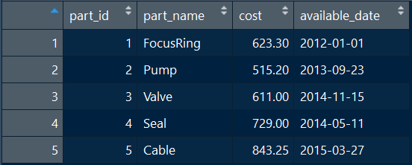
Data Frame Data Classifications Example
Integer is a number that doesn’t contain a decimal
Number contains a decimal
Character are letters
Date is date formatted data
5 rows (obs)
4 columns (variables)

Slide 6
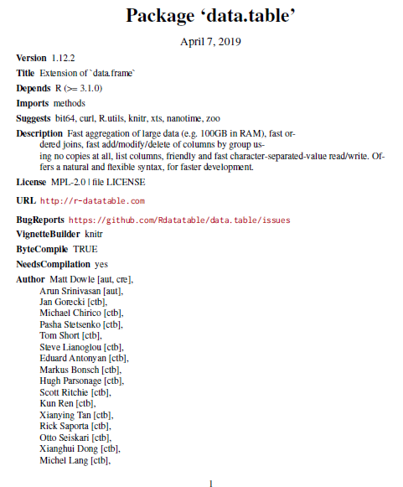
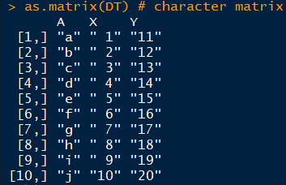
Library
R allows data community to create packages. Library() command is used to load a package
Libraries can be considered as a specialty set of functions that support a specific function.
library(data.table) # activate library before using function
DT <- data.table(A = letters[1:10], X = 1:10, Y = 11:20)
as.matrix(DT) # character matrix
Package manual can be found via browser.
Google = “data.table package”
Link

Slide 7


Special Characters
When R comes across a \ it assumes you are starting an escape, so if you actually need a backslash in your string you'll need the sequence \\
Below examples are using grepl (searching for a character or pattern of characters)
[ = special character
\\ before special character
TRUE = character exists

Slide 8
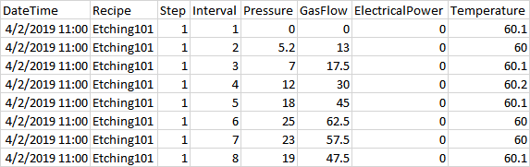
Basic Concepts | Single File Input & Output
<- is an operator to assign a variable name to a variable
f0 <- file.choose() #select csv file
f1 <- read.csv(f0, header = TRUE,sep = ",") # load csv file
write.csv(f1,"session1 file.csv",row.names = FALSE) # save file

Slide 9

Basic Concepts | Multiple File Input & Output
library(plyr)
folderLocation <- choose.dir() # select folder with data files
vctFiles <- c(list.files(path = folderLocation,pattern = "csv", recursive = FALSE)) #list files that contain csv
total.logs <- length(vctFiles) #log count needed for loop
#create loop
datalist10 = list() # create blank data frame to consolidate file data
for ( j in 1:length(vctFiles) )
{
lp_file <- vctFiles[j] #file being processed
{
f1 <- read.csv(lp_file, header = TRUE, sep = ",") # load file j
datalist10[[j]] <- f1 #pastes data into blank data frame
}
}
f2=rbind.fill(datalist10,f1) # combines all datalist10 data into single data frame
File1.csv
File2.csv
File3.csv
{
j = 1 (File1.csv)
j = 2 (File2.csv)
j = 3 (File3.csv)
j = each file gets inserted into loop one at a time
datalist10 contains File1-3 data
{
f2 contains combined File1-3 data (stacked)

Slide 10
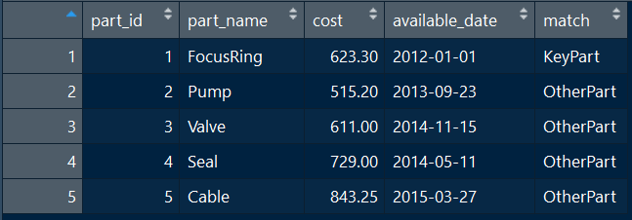
Logical Operators & ifelse syntax
part_data$match <- ifelse(part_data$part_name == "FocusRing", "KeyPart", "OtherPart")
Operator | Description
< | less than
<= | less than or equal to
> | greater than
>= | greater than or equal to
== | exactly equal to
!= | not equal to
!x | Not x
x | y | x OR y
x & y | x AND y
isTRUE(x) | test if X is TRUE
https://www.statmethods.net/management/operators.html

Slide 11
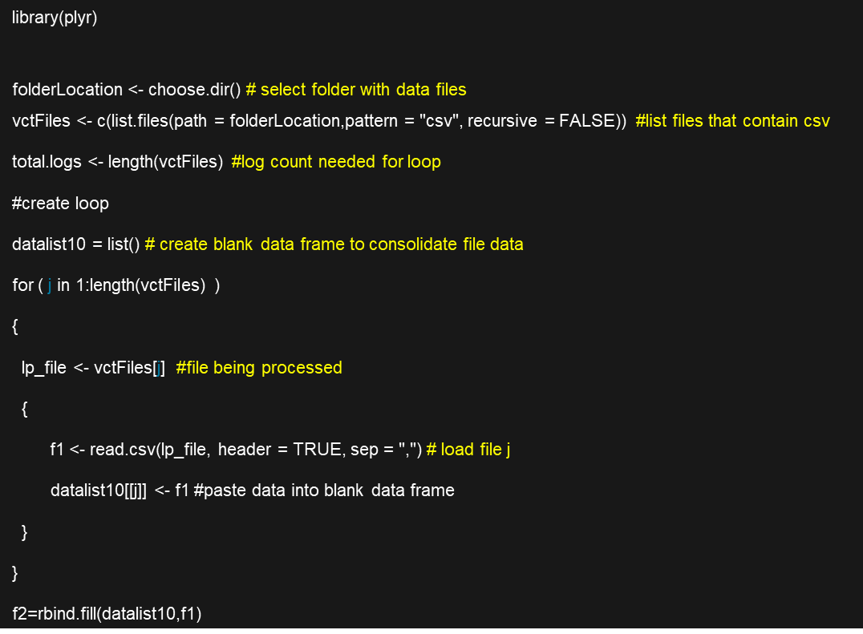
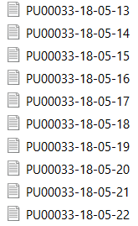
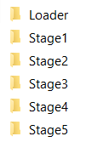
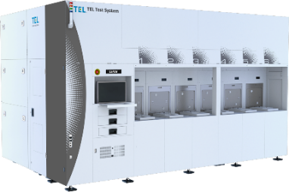
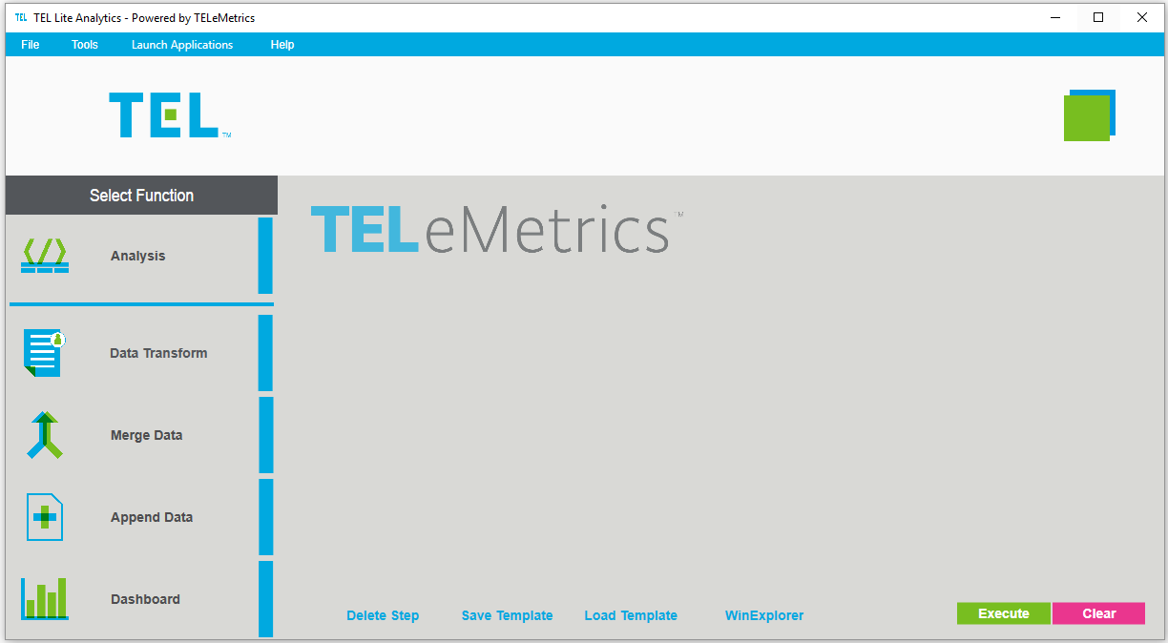
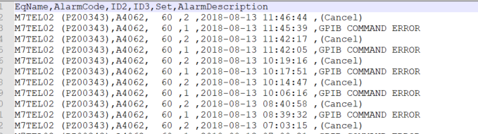
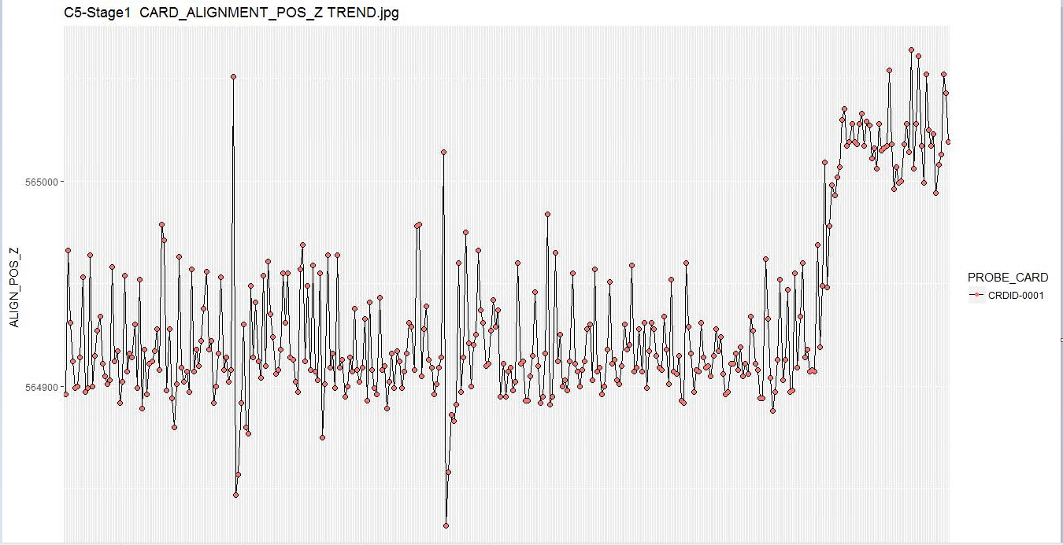





Basic Objective | Raw Data to Visualization
Your laptop
Course goal is to provide data skill to format files into usable format
Individual files
Combine files & fix format
Output files. (.csv, .jpn, …)
Processing data
<5 minutes
Download files
from tool with USB.
(or via RS connection.)
Visualize output files
Analyze data for insight
Import files
TLA custom outputs from R

Slide 12
Sessions

Slide 13
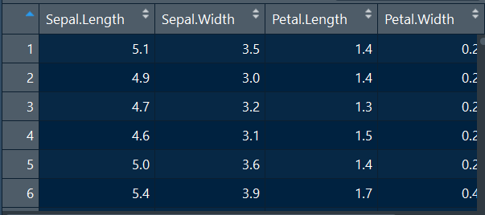
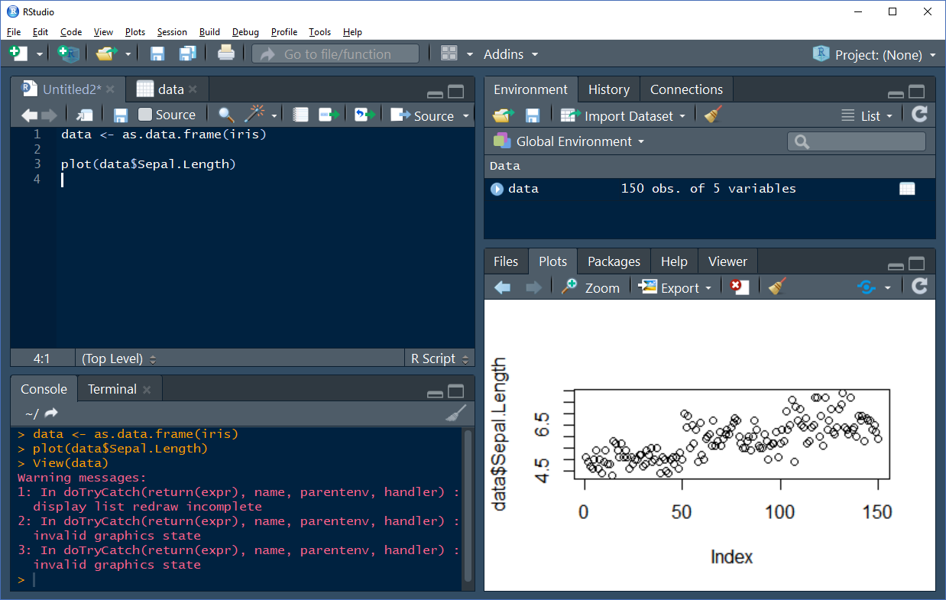
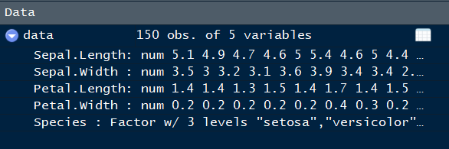
R Studio Overview
Data
New r file
Scripting window
Variables & data
Plots
Console window

Slide 14
Art of Data Wrangling
Goal is get unstructured data into a usable structure so insight can be gathered.
Basic questions
What insight is needed?
Is the file content structured or unstructured?
Are there calculations?
Are statistical calculations required?
Are graphs required?
Does this data need to be merged with other data? Merge key?

Slide 15
Session 1 | Single Structured File
<- is an operator to assign a variable name to a variable
f0 <- file.choose() #select csv file
f1 <- read.csv(f0, header = TRUE,sep = ",") # load csv file
write.csv(f1,"session1 file.csv",row.names = FALSE) # save file

Slide 16

Session 2 | Multiple Structured Files Example 1
library(plyr)
folderLocation <- choose.dir() # select folder with data files
vctFiles <- c(list.files(path = folderLocation,pattern = "csv", recursive = FALSE)) #list files that contain csv
total.logs <- length(vctFiles) #log count needed for loop
#create loop
datalist10 = list() # create blank data frame to consolidate file data
for ( j in 1:length(vctFiles) )
{
lp_file <- vctFiles[j] #file being processed
{
f1 <- read.csv(lp_file, header = TRUE, sep = ",") # load file j
datalist10[[j]] <- f1 #pastes data into blank data frame
}
}
f2=rbind.fill(datalist10,f1) # combines all datalist10 data into single data frame
{
j = 1 - 5
j = each file gets inserted into loop one at a time
datalist10 contains File1-5 data
{
f2 contains combined 1-5 data (stacked)

Slide 17
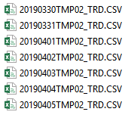
Session 2 | Multiple Structured Files Example 2
library(plyr)
folderLocation <- choose.dir() # select folder with data files
vctFiles <- c(list.files(path = folderLocation,pattern = "csv", recursive = FALSE)) #list files that contain csv
total.logs <- length(vctFiles) #log count needed for loop
#create loop
datalist10 = list() # create blank data frame to consolidate file data
for ( j in 1:length(vctFiles) )
{
lp_file <- vctFiles[j] #file being processed
{
f1 <- read.csv(lp_file, header = TRUE, sep = ",") # load file j
datalist10[[j]] <- f1 #pastes data into blank data frame
}
}
f2=rbind.fill(datalist10,f1) # combines all datalist10 data into single data frame
{
j = 1 - 7
j = each file gets inserted into loop one at a time
datalist10 contains File1-7 data
{
f2 contains combined 1-7 data (stacked)

Slide 18
Session 3 | Art of Data Wrangling
Goal is get unstructured data into a usable structure so insight can be gathered.
Basic questions
What insight is needed?
Is the file content structured or unstructured?
Are there calculations?
Are statistical calculations required?
Are graphs required?
Does this data need to be merged with other data? Merge key?

Slide 19
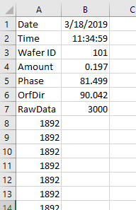
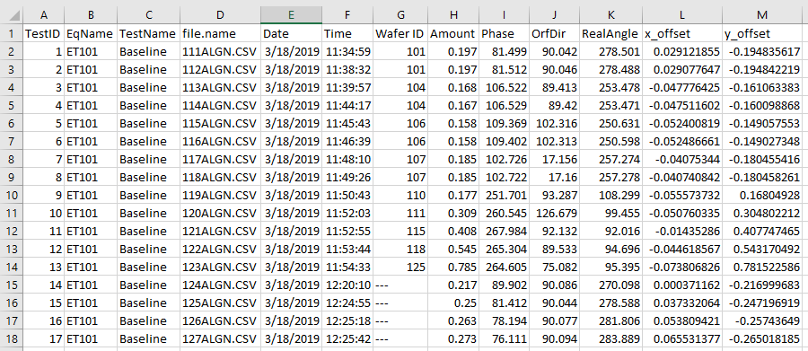
Session 3 | Multiple Unstructured File Example 1
Rows 1 to 6
User variables
Source file (rows 1-6)
User calculations

Slide 20
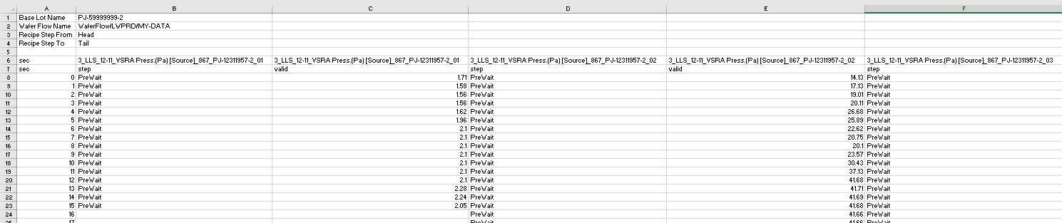
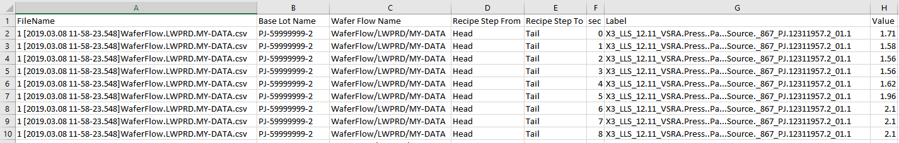
Session 3 | Multiple Unstructured File Example 2

Slide 21
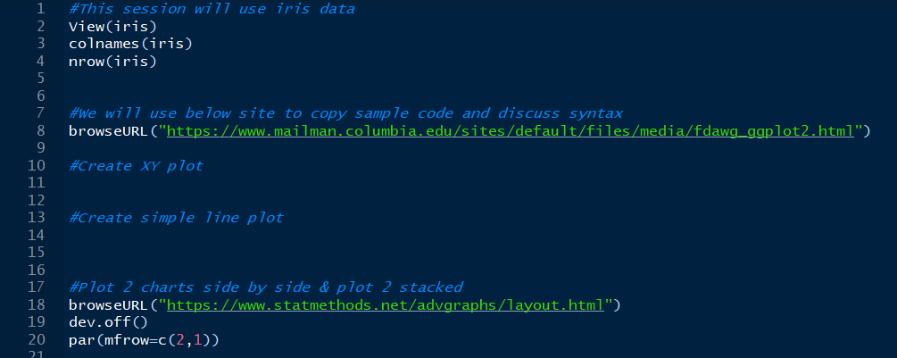
Session 4 | Plotting Basics
We’ll be using iris built in dataset for this session
Your Session 4 folder contains a start r script file

Slide 22
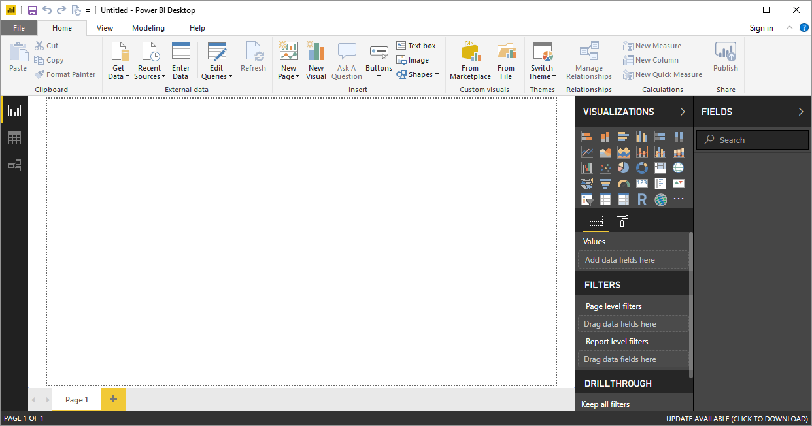
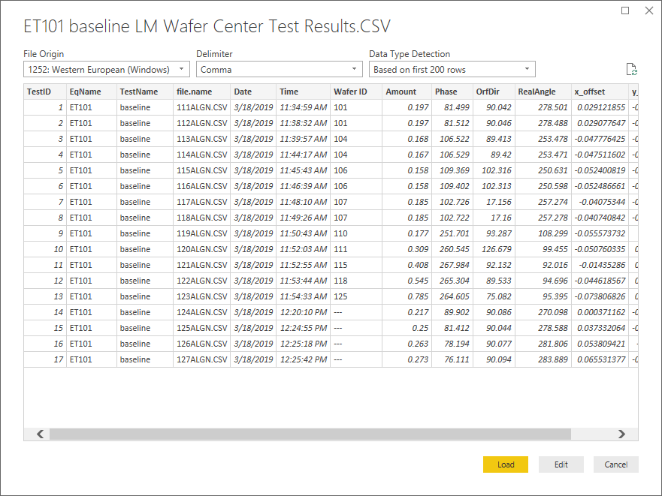
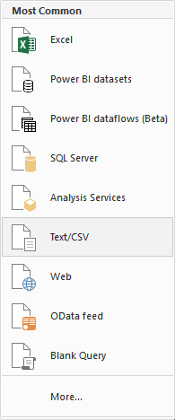
Session 5 | Power BI Desktop Training, Loading Data
Utilize Encoding=932 for Japanese characters

Slide 23
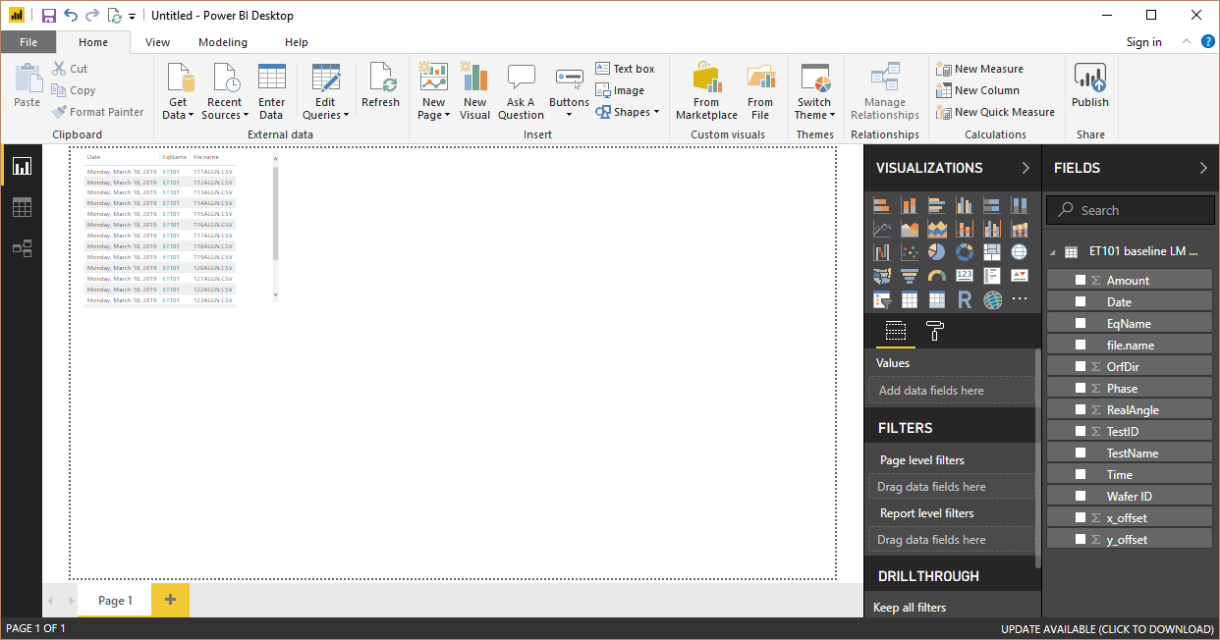
Session 5 | Power BI Desktop Training, Hands On
Data columns

Slide 24
Session 6 | Lite Analytics MyScripts
Lite Analytics will pass args (arguments) to R
Within your R script you can utilize the args to locate a folder and pass parameters
Folder location
Tool Name
Recipe Name
Chart flag
Below link has instructions and developer template
http://tech-sup.sp.us.tel.com/remote/tla/SitePages/TLA%20Training%20Materials.aspx

Slide 25
Session 7 | Wrap Up
Lite Analytics and R can be combined to process many files and Power BI can be utilized for a interactive visualization tool.
R has much more capability related to data science.
It’s important to have a strong grasp of key data wrangling concepts and hands on experience.
Combing equipment experience with data skills is a great combination.
Let us know if we can support your projects or any questions, tla_support@us.tel.com

